Slide 1
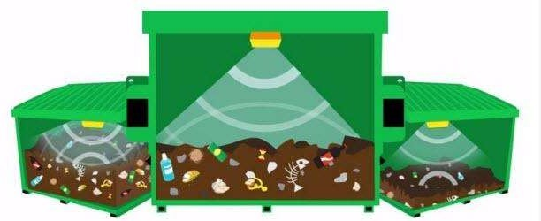


Smart Garbage Monitoring System Using Internet of Things (IOT)
By K. N. S. Sri Harsha 18R01A0481
1

Slide 2
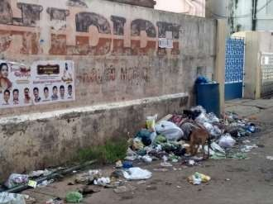
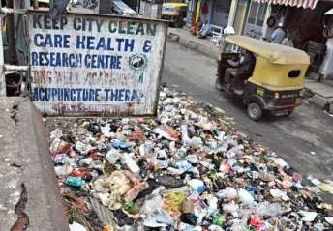
PROBLEMSTATEMENT
One of the main concerns with our environment has been solid waste management which impacts the health and environment of our society.
The detection, monitoring and management of wastes is one ofthe primary problems of the presentera.
The traditional way of manually monitoring the wastes in waste bins is a cumbersome process and utilizes more human effort, time and costwhich can easily be avoided with our presenttechnologies.
2

Slide 3
Disadvantages of the existing system
Time consuming and less effective
High costs
Creates unhygienic environment and look of the city
Bad smell spreads and may cause illness to human beings.
3

Slide 4
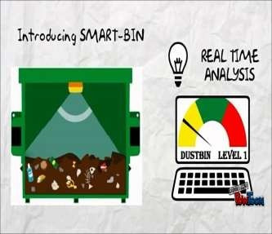
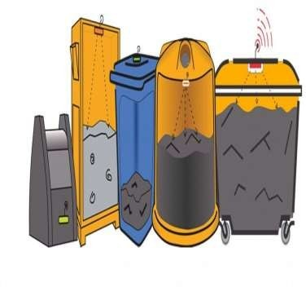
SOLUTION
What our system does is it gives a real time indicator of the garbage level in a trashcan at any given time.
Using that data we can then optimize waste collection routes and ultimately reduce fuel consumption. It allows trash collectors to plan their daily/weekly pick up schedule.
4

Slide 5




COMPONENTSOF SYSTEM
Components | Models | Quantity
Ultrasonic sensor | HC-SR04 | 1
Wi-Fi shield | ESP8266 | 1
Microcontroller | Arduino (UNO) | 1
Connecting wires | Jumper-Wire | 10
2G0M/ 1S0/
5

Slide 6
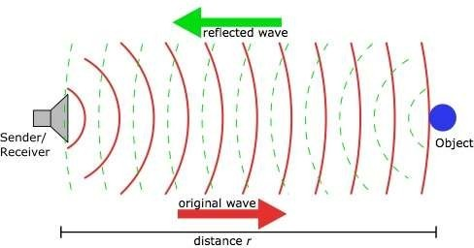
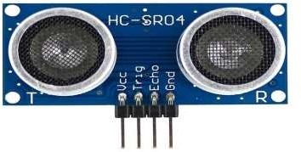
ULTRASONICSENSOR
Asthe name indicates, ultrasonic sensors measure distance by using ultrasonic waves.
The sensor head emits an ultrasonic wave and receives the wave reflected back from the target. Ultrasonic Sensors measure the distance to the target by measuring the time between the emission and reception.

Slide 7
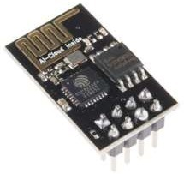
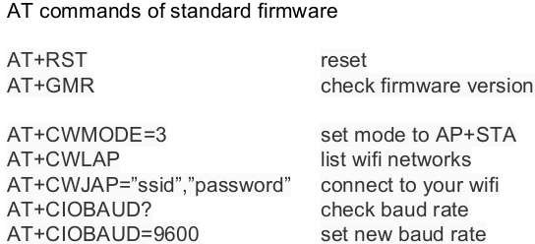
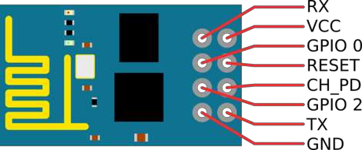
ESP8266
The ESP8266WiFi Module is a self contained SOCwith integrated TCP/IP protocol stack that can give any microcontroller access to your WiFi network.
EachESP8266module comes pre-programmed with an ATcommand set firmware.

Slide 8
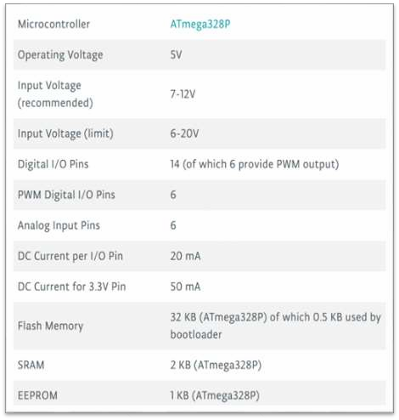
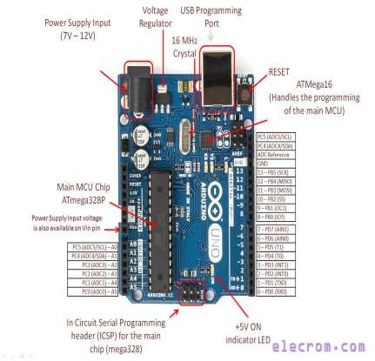
Arduino (UNO)
Arduino Uno is a microcontroller board based on the ATmega328P. It has 14 digital input/output pins (of which 6 can be used as PWM outputs), 6 analog inputs, a 16 MHz quartz crystal.

Slide 9
METHODOLOGY:
An ultrasonic sensor will be placed on the interior side of the lid, the one facing the solid waste. As trash increases, the distance between the ultrasonic and the trash decreases. This live data will be sent to our micro- controller.
Micro- controller then processes the data and sends tothingspeak with the help of Wi-Fimodule.

Slide 10
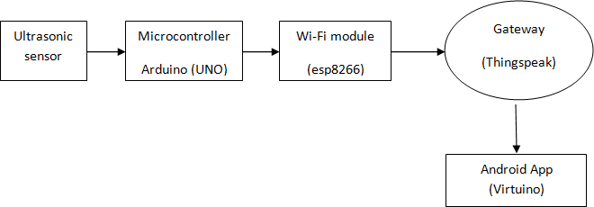
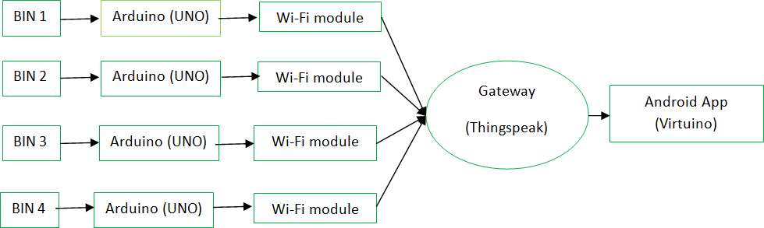
METHODOLOGY:

Slide 11
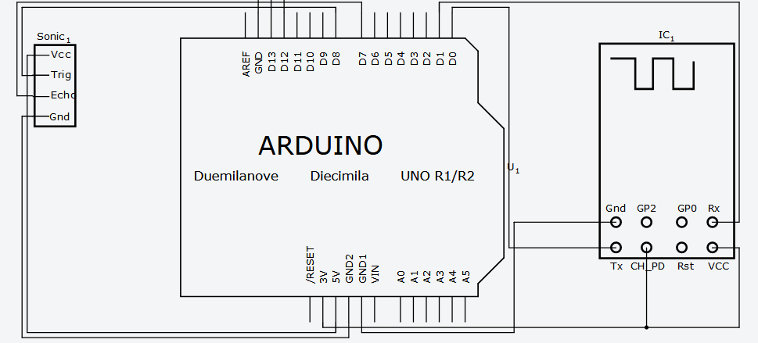
CONNECTION DIAGRAM:

Slide 12
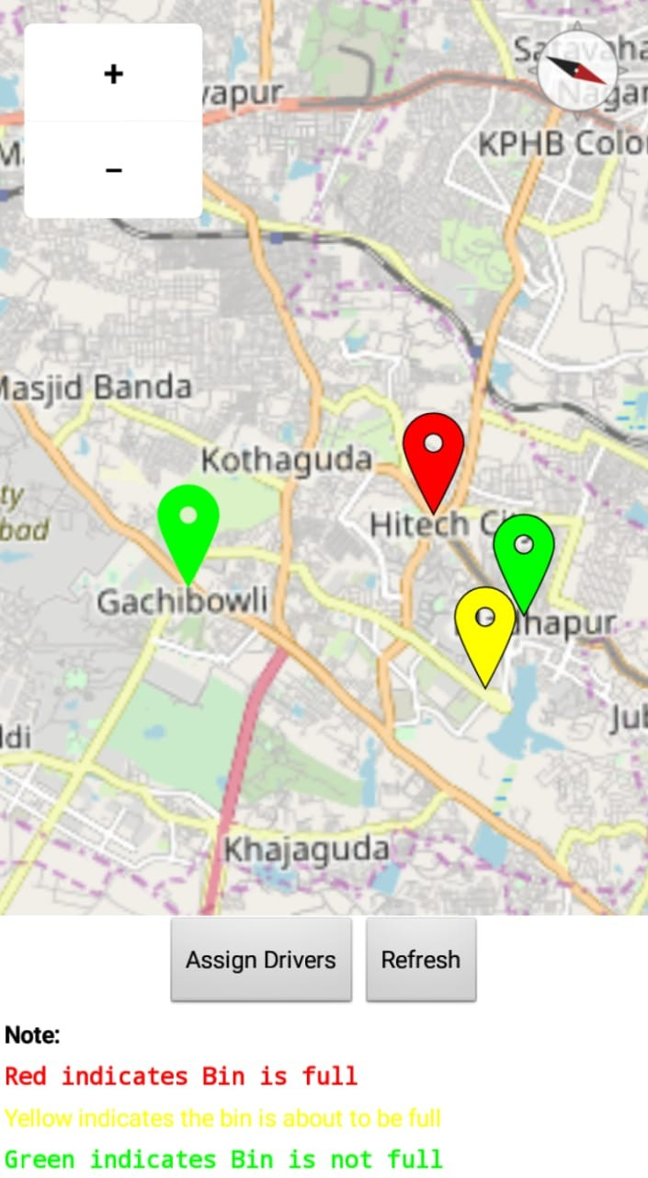
PROTOTYPE ANDROID APPLICATION

Slide 13
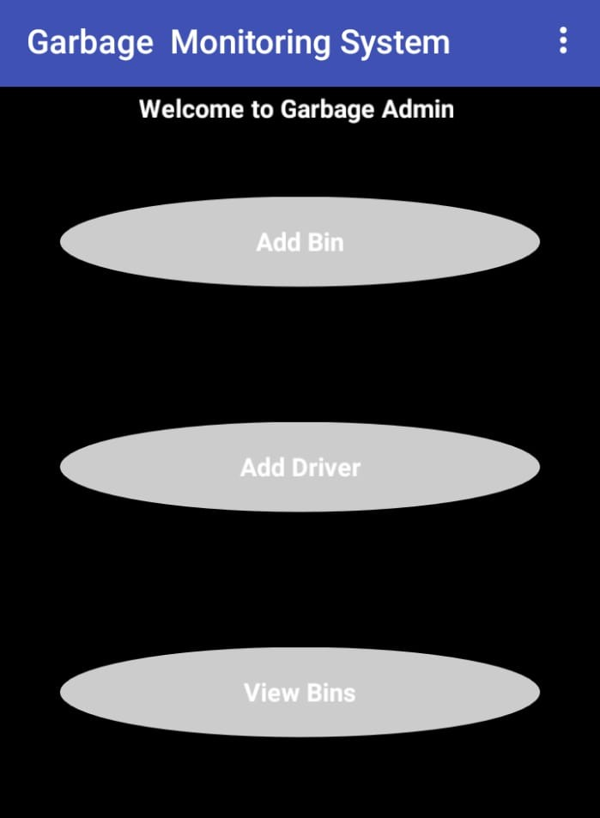

Slide 14
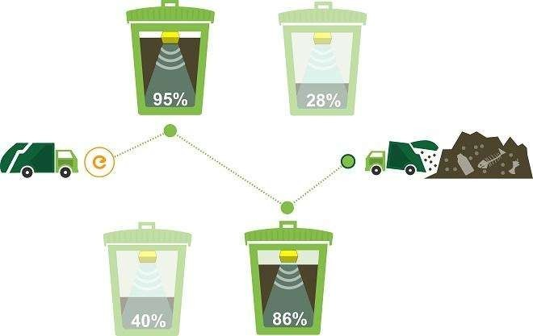
ADVANTAGE OF SMART GARBAGE MONITORING

Slide 15


ADVANTAGEOFSMARTGARBAGEMONITORING
Dynamic routing
The solution optimizes waste collection routes and schedules based on real-time and historical data, provides predictive analytics to enable decision making ahead of time, and offers consultation on waste bin allocations.
Cost reduction
Our smart waste logistics solution reduces waste collection frequency dramatically, which enables you to save on fuel, labor,and fleet maintenance costs.

Slide 16
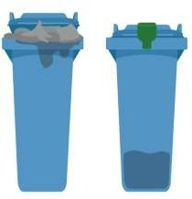

ADVANTAGEOFSMARTGARBAGEMONITORING
Improved cleanliness
In densely populated areas, a rapid waste
generation often leads to overflowing waste bins and unsightly streets. Our solution enables waste collection staff to read fill- levels in real time and receive notifications of waste overflows.
CO₂reduction
Collecting garbage is a very pollutant heavy proposition. Our solution offers you the means to
have less trucks on the road forless time, which means less greenhouse gas emissions, less noise
pollution, and less road wear.

Slide 17
Disadvantages of Smart Garbage System
System requires more number of waste bins for separate waste collection as per population in the city. This results into high initial cost due to expensive smart dustbins compare to other methods.
➨Sensor nodes used in the dustbins have limited memory size.
➨Wireless technologies used in the system such as zigbee and wifi have shorter range and lower data speed. In RFID based systems, RFID tags are affected by surrounding metal objects (if any).
➨It reduces man power requirements which results into increase in unemployment for unskilled people.
➨The training has to be provided to the people involved in the smart waste management system.

Slide 18

REFERENCE
https://www.arduino.cc/
https://thingspeak.com
https://www.instructables.com/
https://circuits.io
https://circuits4you.com
https://codebender.cc/

Slide 19

THANK YOU

